Slide 1
Robotic Process Automation

Slide 2
Introduction
The client Memorial Herman interacts with multiple external vendors. Due to different vendors systems it is difficult to integrate all systems together which ended up in a multiple manual time-consuming human tasks.
Most time consuming tasks in this process is excel conversations and excel comparisons

Slide 3
Business Objectives for Bot 1 - Vendor Placement Process
Reduce time consuming manual tasks from vendor management process
Assign manual csv and excel conversion tasks to RPA bot
Reduce some load from existing team
Get some data analytics using RPA services
Implement notifications for vendor management team and for vendors
Identify early discrepancies

Slide 4
Major Challenges
The major challenges faced during the use case are:
Excel conversations and excel comparisons because of very bad input data
Unstructured column names
Input files containing extra symbols like brackets, hyphen, Apostrophe comma, extra date row etc. in columns
Frequent changes in business rules to process input files (Eg: Picking current date-1 file instead of current date file etc)

Slide 5
Solution Provided using RPA UiPath
Instead of automating entire processes we will focus on time-consuming manual human tasks which is excel/csv conversions and will replace it with RPA Bots. The primary objectives for this use case is to perform excel sheets reconciliations and read reports csv file, compare it with others and generate result files.
Technical Steps:
Extract data from CSV file generated by ISD Team
Build Excel sheets
Compare data between CSV and Excel
Analyze data and prioritize valuable transactions
Predict discrepancies early and notify vendors
Automate discrepancy detection process

Slide 6
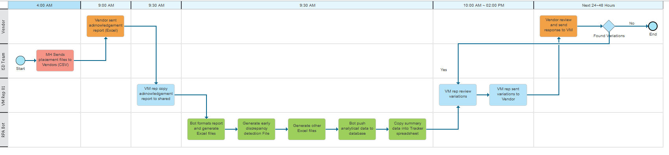
Workflow

Slide 7
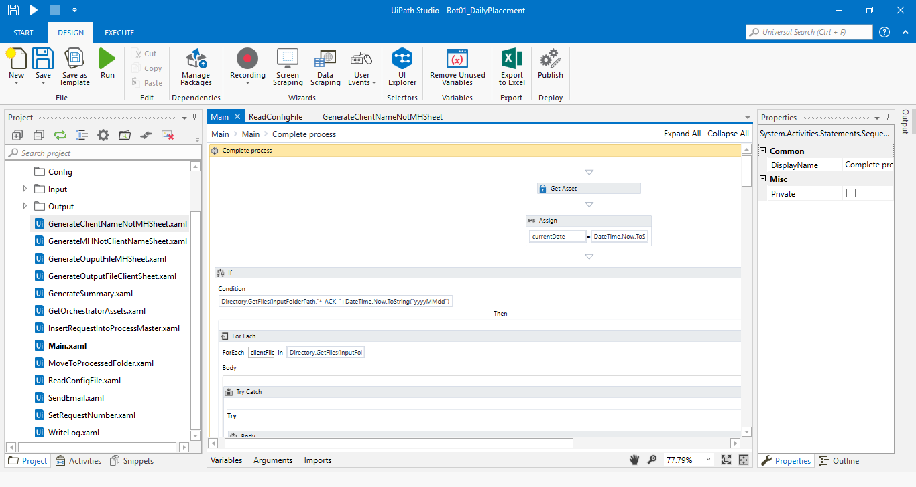
Fig: UiPath Bot Design Studio

Slide 8
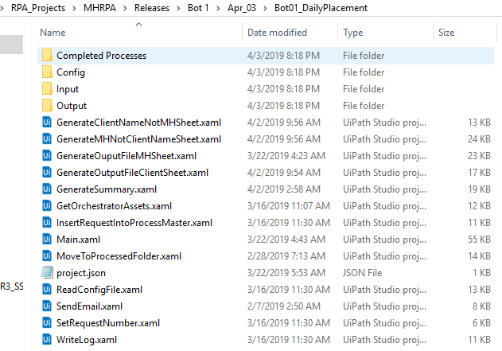
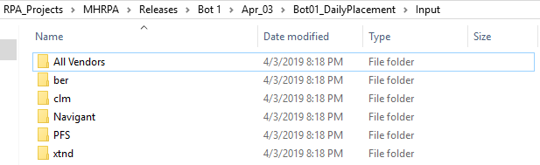
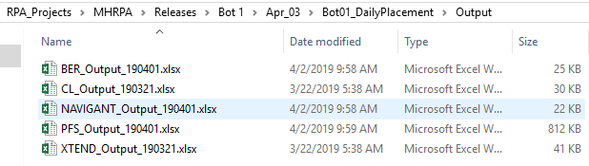
Screen Shots:
Fig: Input Folder
Fig: Project Structure
Fig: Outputs

Slide 9
Business Objectives for Bot 5 – Web Posting Process
Reduce time consuming manual tasks from Web Posting process
Identify the vendor based on input file and proceed further for the respective website
Invoke Desktop and Mainframe applications for capturing screenshot and writing memorandum
Assign manual website form filling tasks to RPA bot
Reduce some load from existing team
Get some data analytics using RPA services
Implement notifications for vendor management team and for vendors
Identify early discrepancies

Slide 10
Major Challenges
The major challenges faced during the use case are:
Data scrapping from the web page wherein the website is not having go to next page button
Capturing all exception messages and writing them onto Mainframe application memorandum
Defining business rules based on multiple input files for Aetna Web posting
Integration of Desktop recording and Mainframe recording process with Web recording process.

Slide 11
Solution Provided using RPA UiPath
Instead of automating entire processes we will focus on time-consuming manual human tasks which is filling web form from input csv file and will replace it with RPA Bots. The primary objectives for this use case is to read patient data, identify payer and fill the patient data to the respective payer website and generate status result file.
Technical Steps:
Read input csv file
Open respective website
Fill the patient data as per the business rules
Capture screenshot and write memorandum
Generate Status report
Predict discrepancies early and notify vendors

Slide 12
Workflow
Reading Input File STCU_TESTRPT
Posting Patient Data To The Respective Web Site
Integrating Desktop App PixCert For Capturing Screenshot
Generating Status File
Integrating Mainframe App Health Quest And Writing Memo

Slide 13
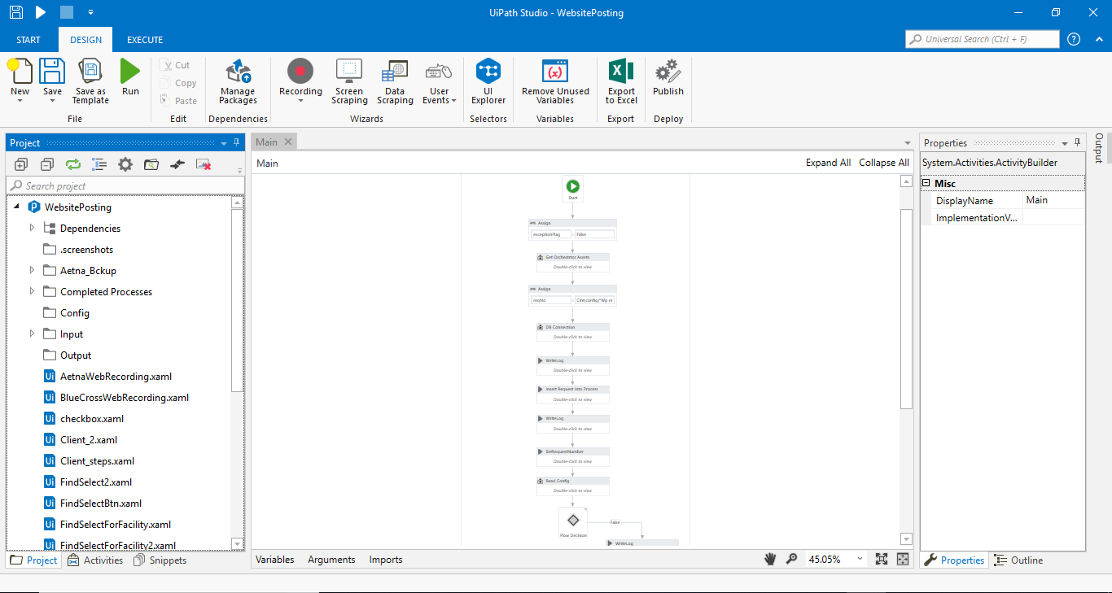
Fig: UiPath Bot Design Studio

Slide 14
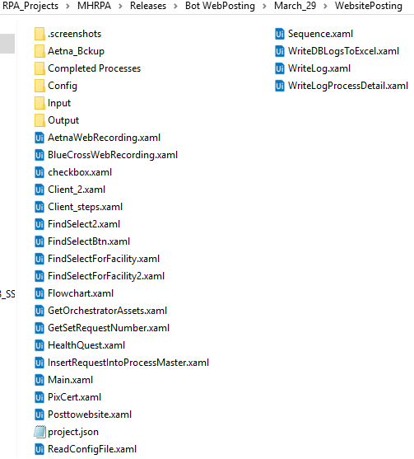

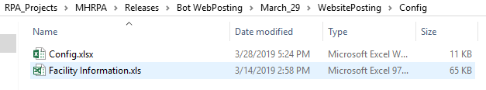
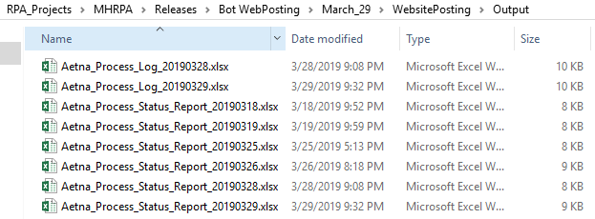
Screen Shots:
Fig: Input Folder
Fig: Config File
Fig: Project Structure
Fig: Outputs

